Slide 1
Memorandum of Agreement between
ODFW and the Cow Creek Band of Umpqua Tribe of Indians
December 16, 2022
Davia Palmeri, ODFW Conservation Policy Coordinator
Carla Keene, Tribal Chairman
Michael Rondeau, CEO & Tribal Administrator
Jason Robison, Land and Resources Officer
Kelly Coates, Director of Natural Resources
Anthony Broadman, Tribal Legal Counsel

Slide 2
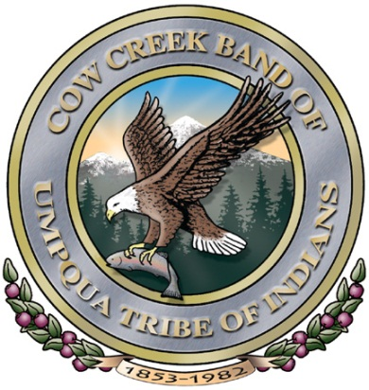
Cow Creek Band of Umpqua Tribe of Indians History
The Cow Creek Band of Umpqua Tribe of Indians is one of nine federally recognized Sovereign Indian Tribal Governments in the State of Oregon.
The Cow Creek Umpqua (Nahánkʰuotana) people are native to Southwestern Oregon and have inhabited these lands since time immemorial.
The Nahánkʰuotana have a deep connection to the land, water, and resources. Traditionally there were abundant resources, and the Tribe practiced a Seasonal Subsistence Round.
Notes:
Kelly

Slide 3
Cow Creek Band of Umpqua Tribe of Indians History
Manifest Destiney and Euro-American settlement was a difficult time for the Tribe. A treaty with the United States Federal Government was entered into on September 19th, 1853.
The Rogue River Wars in 1855-1856 forced Cow Creek Umpqua people to flee deep into the mountains to avoid extermination.
From 1856 to the 1880s there were repeated efforts by the federal government to capture the Cow Creek Umpqua. Tribal people fled into the hills and married into local fur trapping and mining families.
Notes:
Kelly

Slide 4
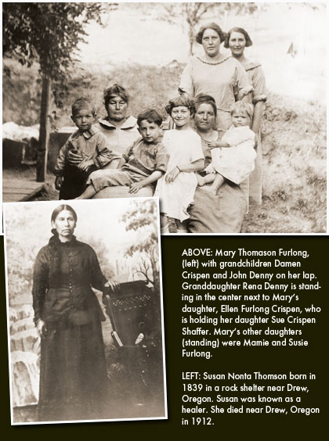
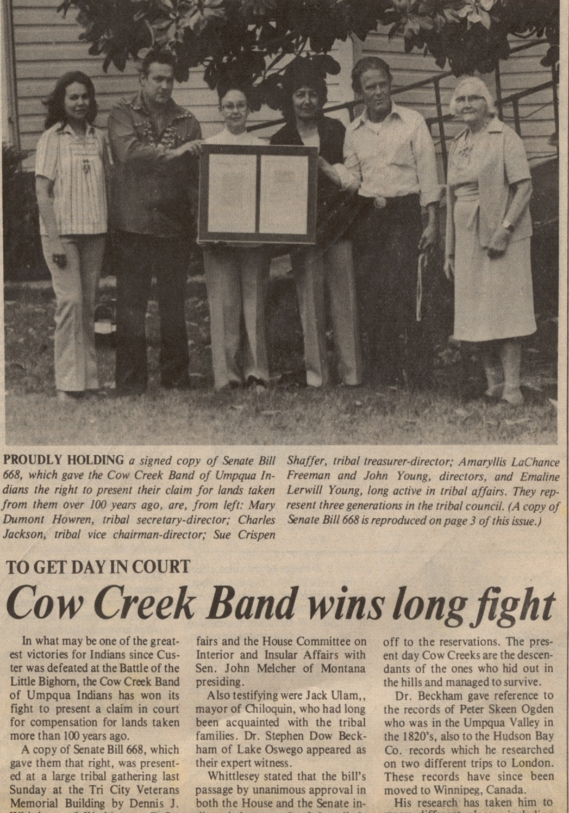
Cow Creek Band of Umpqua Tribe of Indians History
1853 Treaty
Western Oregon Indian Termination Act of 1954
Re-recognition 1982
2018 HR1306 Western Oregon Tribal Fairness Act
Past
Present
Future
Notes:
Michael

Slide 5
Tribal Government
  The Cow Creek Umpqua Tribe is a Sovereign Nation with its own Constitution.
  It is governed by an elected 11-member Tribal Board of Directors.
  The Tribe currently has 1,946 enrolled citizens.
  Paramount for the Tribe today is our connection to the lands and resources that have sustained our traditional lifeways. We are stewards and protectors of the land.
  Natural resources are considered cultural resources and practicing our traditional lifeways of hunting, fishing and gathering are a part of our cultural practices.
  We continue to hold ceremonies for our cultural resources.
Notes:
Michael

Slide 6
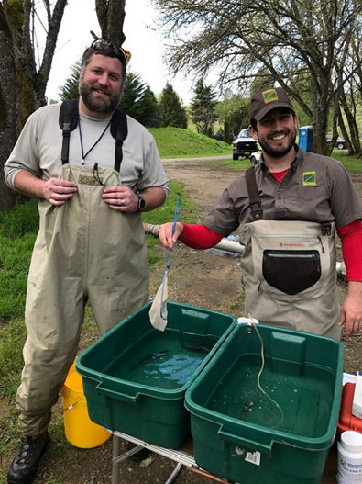
Stewards of the Land and Resources
The Tribe is a steward of the Land and resources.
We use an integrated approach to natural and cultural resources management.
We believe strongly that restoring and preserving habitat is key to species recovery.
We partner with ODFW on research and management.
Tribal and ODFW staff weighing and measuring fish at the Tribal 7 Feathers fish acclimation site.
Notes:
Kelly/Jason

Slide 7
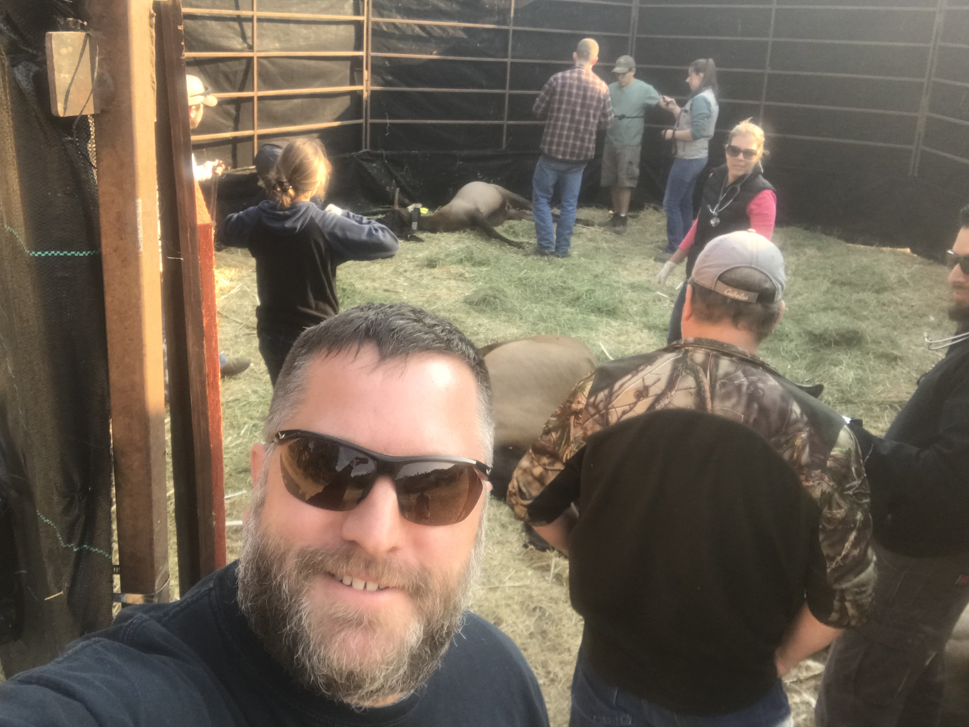
Stewards of the Land and Resources
Cow Creek Tribal Elk Project
Tribal and ODFW staff trapping and collaring elk.
Elk Story Map
https://storymaps.arcgis.com/stories/7c829738a43e4b5b808769f5a3f388d9
Notes:
Kelly/Jason

Slide 8
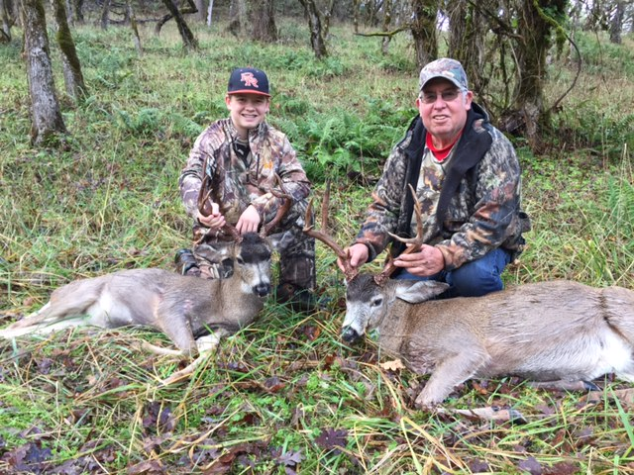
Stewards of the Land and Resources
We continue to practice our traditional lifeways of hunting, fishing and gathering.
We teach future generations about how to be stewards of the lands and resources.
Cow Creek Tribal Elder and Board member Robert VanNorman and his grandson Luke VanNorman after a successful Tribe deer hunt
Notes:
Kelly/Jason

Slide 9
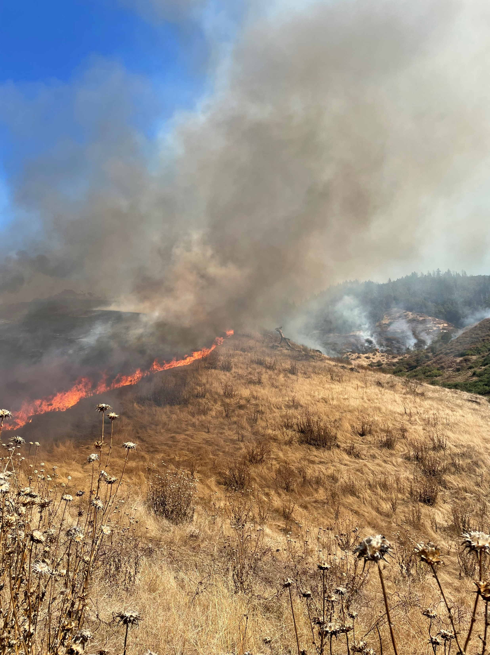
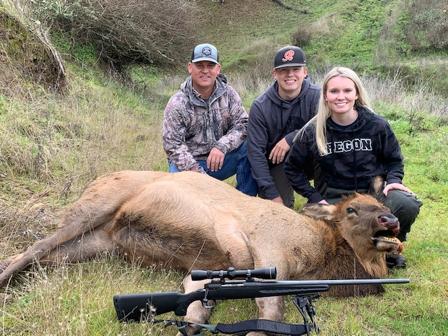
Stewards of the Land and Resources
Cultural burn at Dole Rd.
Tribal members Scott, Luke and Allie VanNorman
Notes:
Kelly/Jason

Slide 10
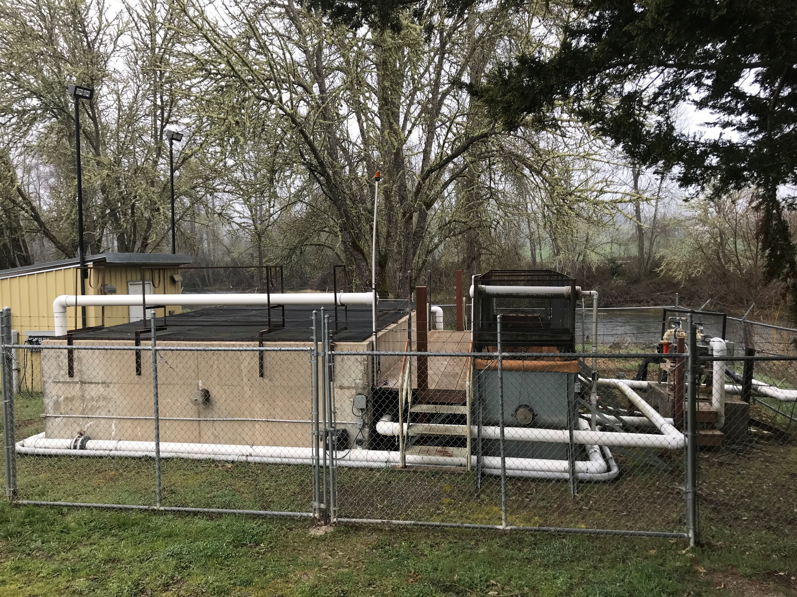
Stewards of the Land and Resources
South Umpqua winter steelhead acclimation partnership with ODFW and the Umpqua Fishermen's Association
This program was created to:
Increase harvest opportunities for anglers on the Main Stem and South Umpqua Rivers
Create more access to a culturally significant species to Tribal Members
  Allow for subsistence fishing
  Other cultural purposes
The Partnership has led to an acclimation research study
Notes:
Kelly

Slide 11
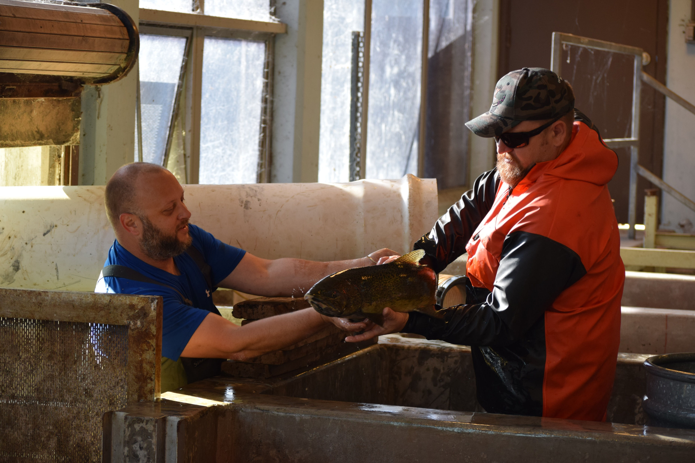
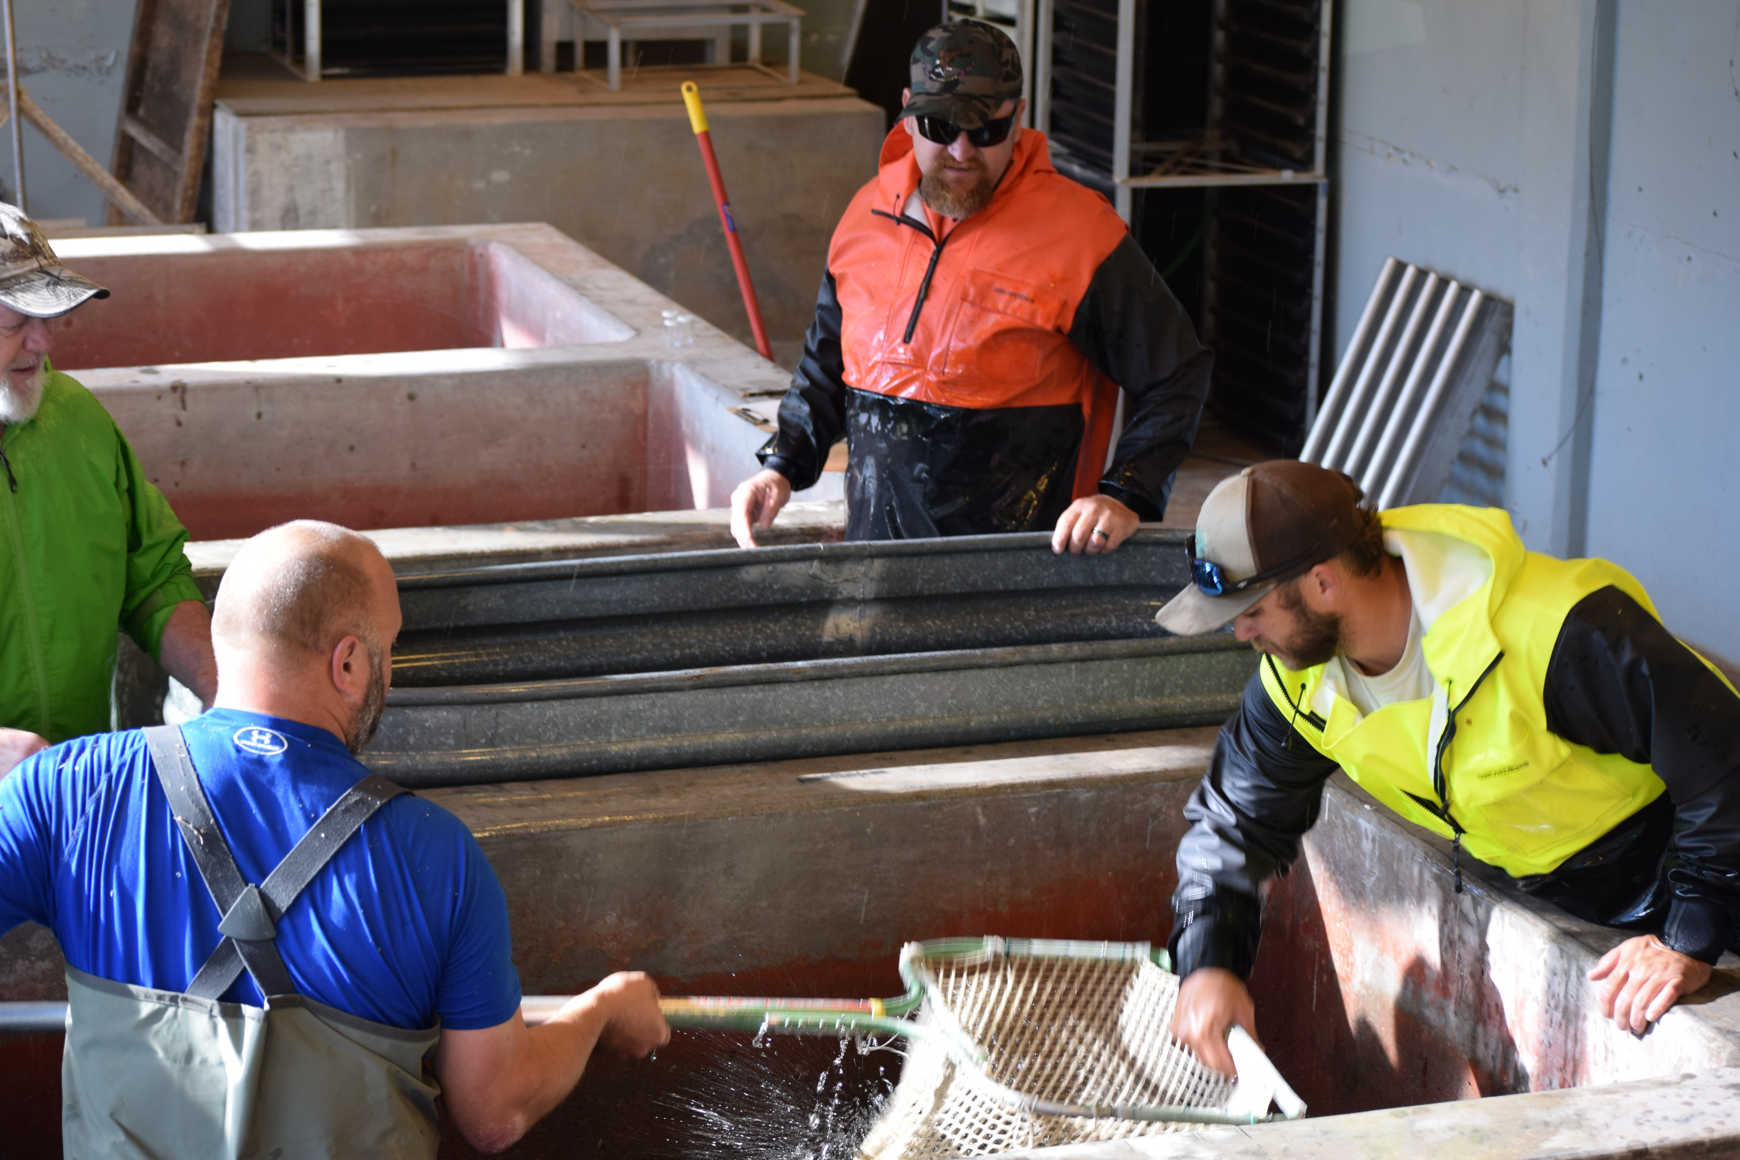
Stewards of the Land and Resources
Cow Creek Umpqua and ODFW staff working together at Cole Rivers Hatchery .
Notes:
Kelly

Slide 12
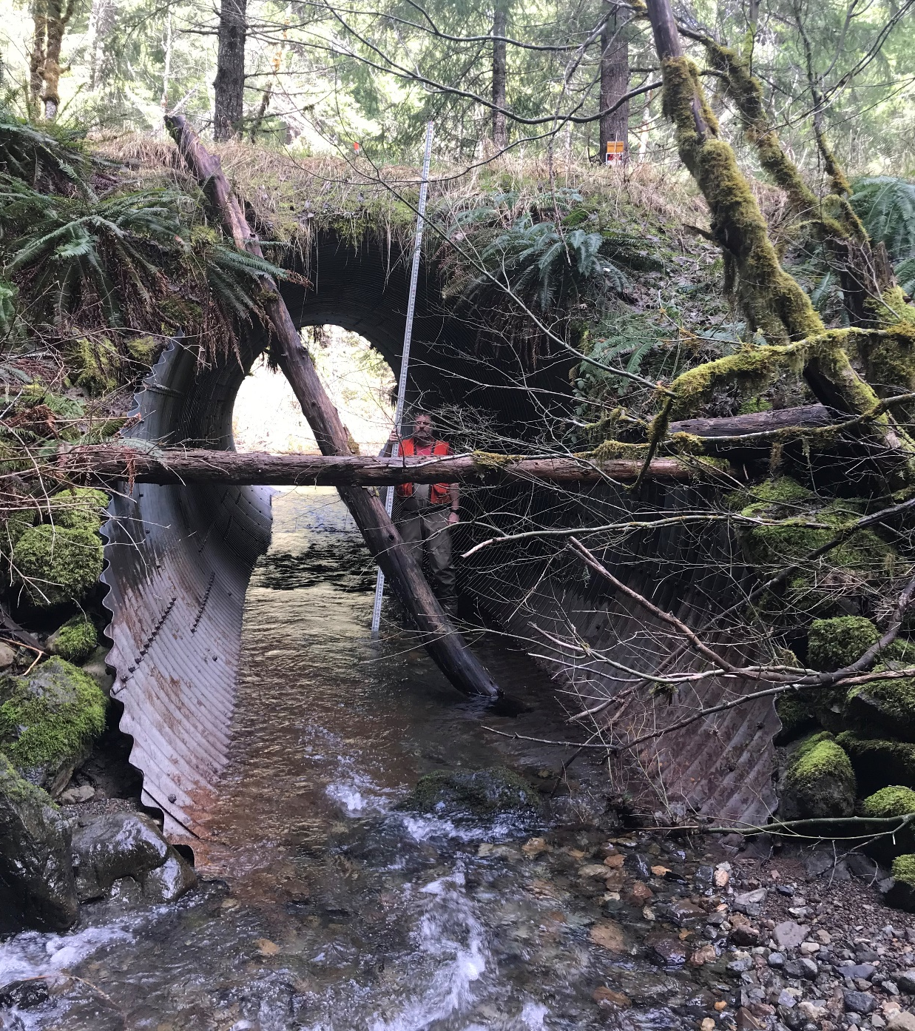
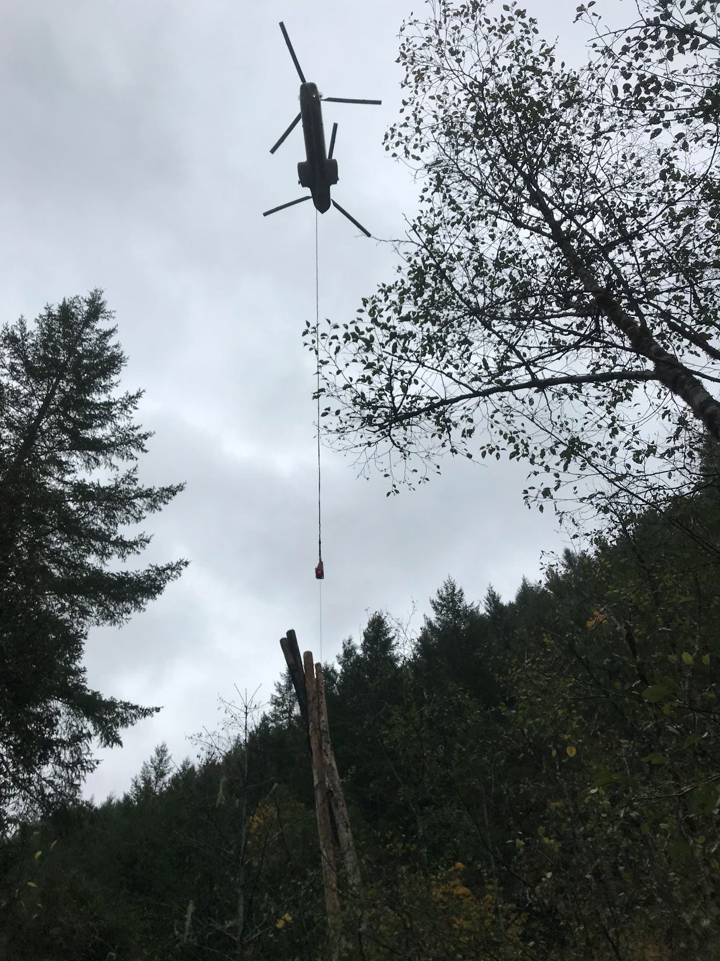
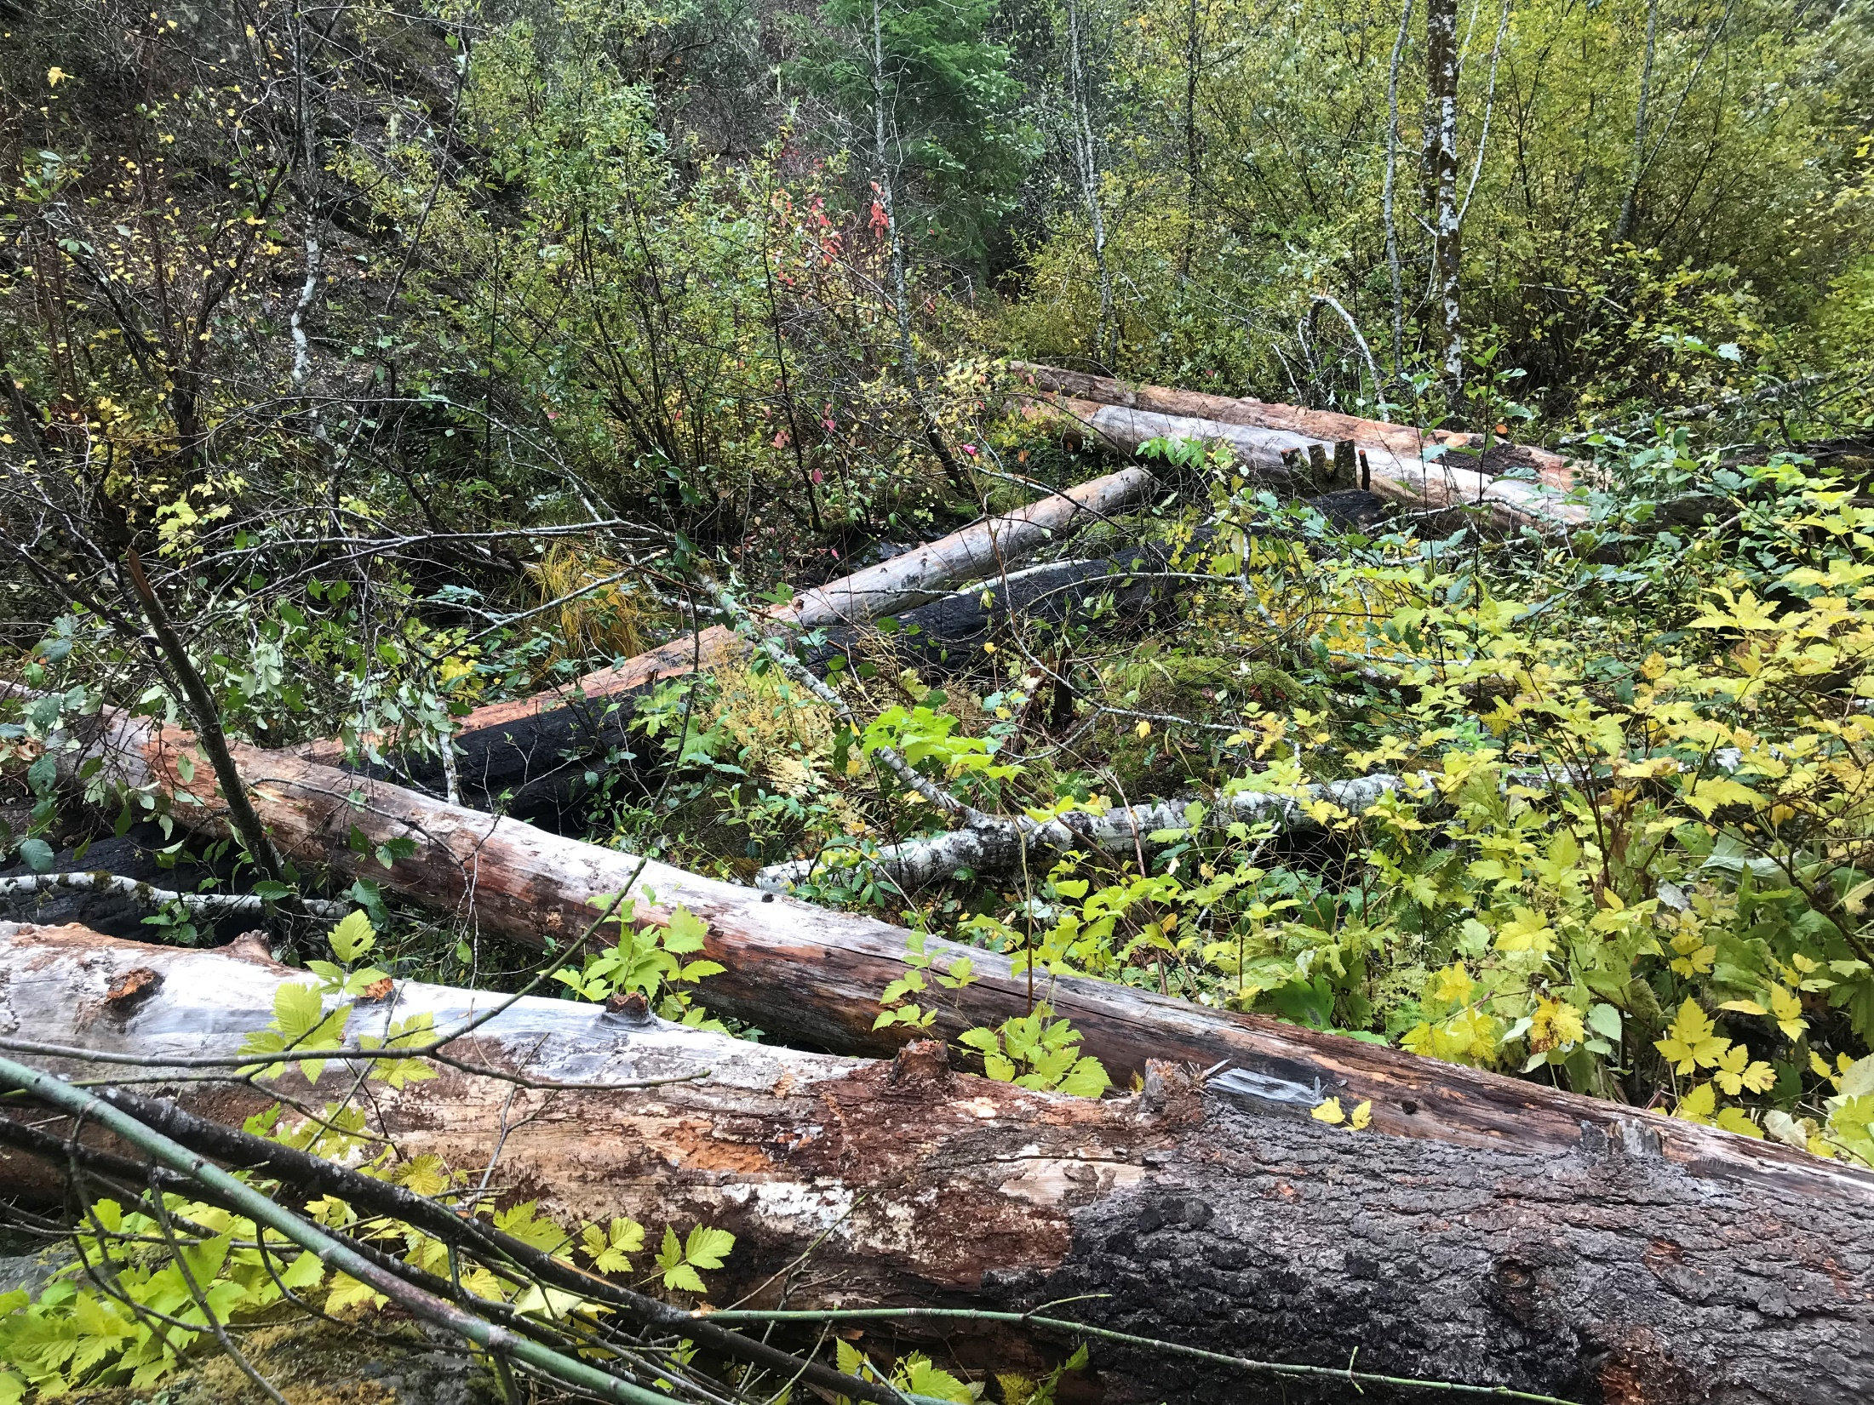
Habitat Restoration
Stewards of the Land and Resources
Log & Boulder Placement
  Adds Complexity / Habitat
  Improves Water Quality
Fish Passage
Notes:
Kelly

Slide 13
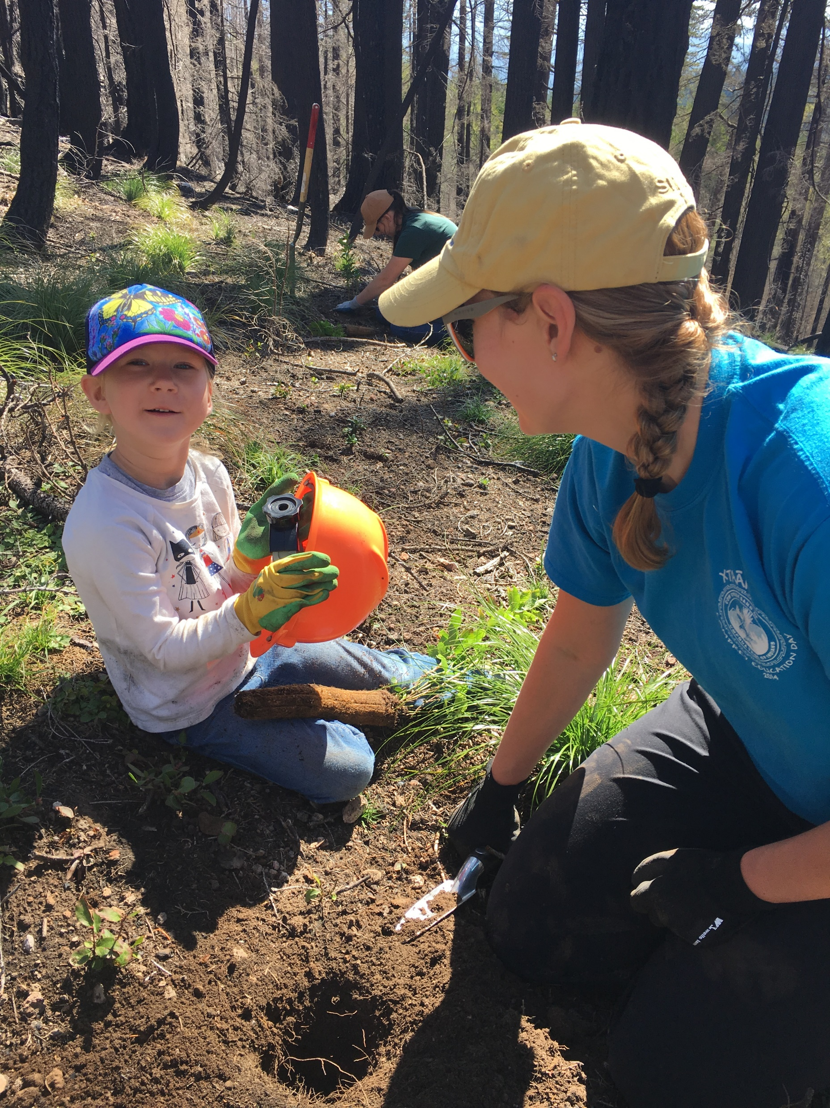
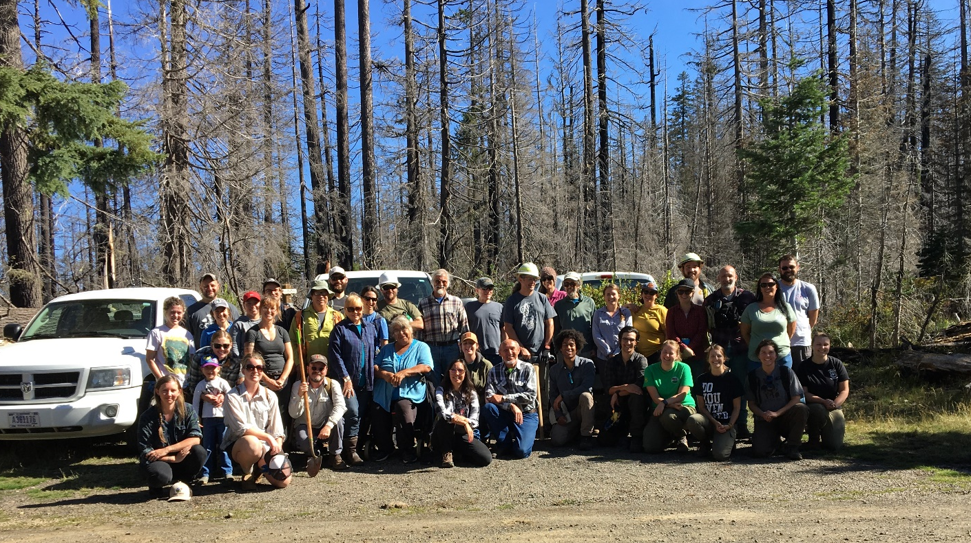
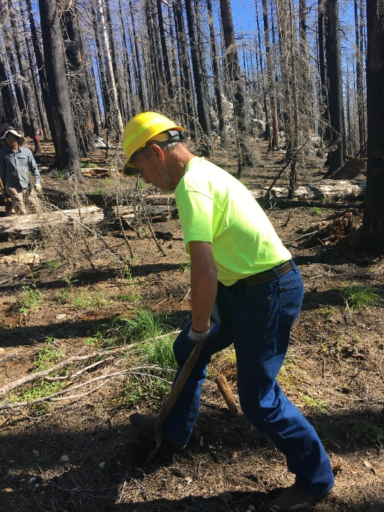
Stewards of the Land and Resources
Huckleberry planting project in the Huckleberry Special Interest Area on the Rogue/Umpqua Divide.
Project between the Cow Creek Umpqua Tribe, Rogue River Siskiyou and Umpqua National Forest and Rogue Native Plant Partnership.
Rogue River Siskiyou NF, RNPP, Tribal staff, elders and youth during huckleberry planting.
Notes:
Kelly

Slide 14
Relevant Commission Authority
Authority over wildlife management - Implement the state’s policies and programs for wildlife management consistent with the state wildlife policy.
Specific authority to prescribe the time, place and manner in which wildlife may be harvested.
Specific authority to prescribe the amounts of wildlife harvest, and to authorize the issuance of permits for the same.
Notes:
Tribal rights are established federally, but the Commission has expansive authority over fishing, hunting, gathering within existing state laws. We are not addressing anything related to the CCBUTI’s rights with this proposed agreement, but rather establishing a broader relationship as a matter of policy.
there are two layers to the authority issue, which are (1) the commission’s authority over the resource; and (2) the commission’s authority to enter agreements like this
Authority over wildlife management - The Commission has the general authority to implement the state’s policies and programs for wildlife management consistent with the state wildlife policy (ORS 496.138 (this is the authority, not intending to cite to the wildlife policy), and the specific authority to prescribe the time, place and manner in which wildlife may be harvested. (ORS 496.162(1).) The Commission also has specific authority to prescribe the amounts of wildlife harvest, and to authorize the issuance of permits for the same. (ORS 496.162(2) & 496.146(4))

Slide 15
Relevant Commission Authority
Authority to enter agreements – Commission has authority to enter into agreements with any person, including tribal governments, for the development and encouragement of wildlife research and management programs and projects.
Notes:
Authority to enter agreements – In addition, the Commission has authority to enter into agreements with any person, including tribal governments, for the development and encouragement of wildlife research and management programs and projects. (ORS 496.146(11) & 190.110.)

Slide 16
Developing the Agreement
June 2022 Request from Tribe to Governor
June 23 Government-to-Government meeting
Fall 2022 CCBUTI shared details with other federally recognized tribes in Oregon
October 18 Public notice and draft agreement filed w/ Secretary of State

Slide 17
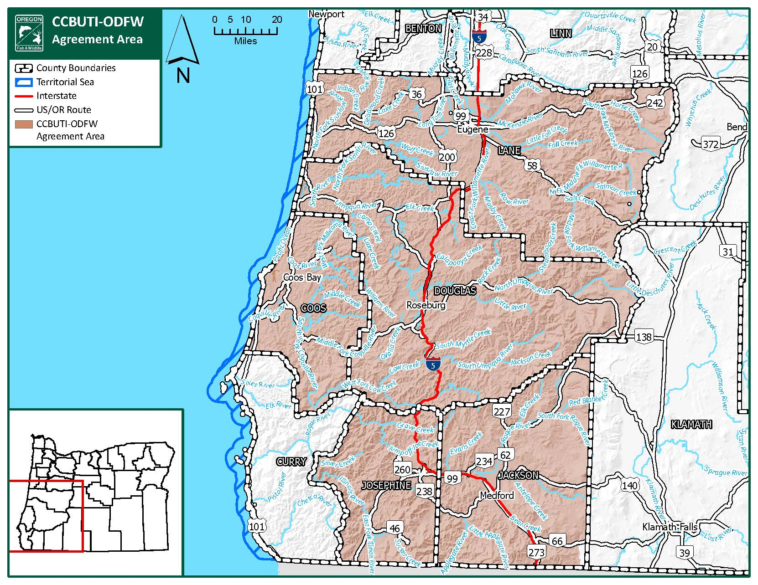
Geographic Scope (Section 5, page 9)
Harvest on private lands only with land-owner permission
Tribal regulations will reflect rules for ODFW owned or managed lands
  Tribe may request exceptions on an annual basis
Non-exclusive: ODFW may enter similar agreements with other tribes in overlapping geography.

Slide 18
Cooperative Management (Section 4, page 8)
Policy statement: The Parties will coordinate the use of their respective authorities, expertise, and influence as regulatory or voluntary opportunities are presented to protect, enhance, and restore fish and wildlife habitat in the geographic scope of this Agreement.
Implementation:
Annual Meeting to identify issues and opportunities
Coordination on pursuit of funding for fish and wildlife management
Sharing data and information

Slide 19
Tribal Harvest (Section 3, page 5)
Intent: Increase opportunities for tribal members to harvest fish and wildlife resources consistent with tribal values
Applies to all finfish, lamprey, shellfish, crustaceans, mammals, and birds managed by ODFW
Applies only to ceremonial and subsistence harvest opportunities
Notes:
Define ceremonial and subsistence harvest.
This does not apply to commercial harvest. Note that there is a provision in the agreement titled “potential future commercial harvest” that acknowledges that the tribe may propose commercial opportunities in the future that may be considered as amendments to this agreement. This is not really a change from the status quo—in the absence of this agreement, the tribe would be able to petition the commission to request creation of a commercial opportunity. Any future commercial activity would be subject to a future Commission decisions.

Slide 20
Tribal Harvest – Limits and Areas (3b-h page 5)
Tribe will provide ODFW with desired species, areas, and numbers annually
Parties hold meeting to seek mutual consent on the above each year
  CCBUTI to coordinate with tribes in overlapping geography
  Dispute resolution provisions
ODFW will issue an annual implementing permit consistent with the negotiated outcome
Notes:
Make sure to talk about implementation and how ODFW will be guided by existing plans, policies, etc. in what we agree to related to species, areas, and numbers.
Different label on existing harvest (not expansion). ODFW guided by existing plans when we go to negotiating table every year. Tribe just as worried about the fish populations, particularly in the Coquille River--transition to the intent for the Tribe to ramp up their habitat work.
Highlight coordination between CCBUTI and CIT

Slide 21
Tribal Harvest – Tribal Regulation (3c-g, page 6)
Tribe will determine method and timing of ceremonial and subsistence opportunities for enrolled members
Tribe will promulgate rules and issue permits/licenses/tags aligned with the above
  Tribe will follow ORS
ODFW and Tribe will annually share data on harvest
Tribal members will carry ID and permits/licenses/tags, present to law enforcement

Slide 22
Other Provisions (Sections 6-14, page 10)
Dispute resolution -> Mediation
Prosecution Referral Agreement
Equity in Cooperative Management Agreements
Perpetual Term
  Effective Date
  Amendments/Termination
  Available Funding and Continued Authority

Slide 23
Response to Public Input (Addendum 1)
Issue
Reference to rights
Applicability of ORS
Resolution
Removed (section 2, pg 5)
Amended language – all ORS apply (section 3d, pg 6)

Slide 24
Implementation
If approved, the MOA will become effective through signatures and creation of OAR 635-800-0200
CCBUTI, ODFW, and OSP to convene ‘summit’ to kick off implementation of the agreement if adopted today.
CCBUTI to adopt harvest regulations in tribal code
Ongoing annual meetings to implement cooperative management.

Slide 25
Cow Creek Umpqua Tribal Action on the Agreement
The Tribal Board of Directors unanimously approved entering into the MOA through Tribal resolution at the November 13th Board meeting.
The Tribe is prepared to amend its legal code to incorporate the agreement upon Commission approval.
The Tribe’s Natural Resources team is ready to work with our Tribal and ODFW partners on management and projects to that will benefit natural and cultural resources.
The Tribe has reached out to interest groups and other Tribes and has received support for the agreement.
Upon approval, the Tribe will schedule a summit to meet with ODFW and Oregon State Police to begin discussing how implementation will roll out.
Notes:
Carla

Slide 26
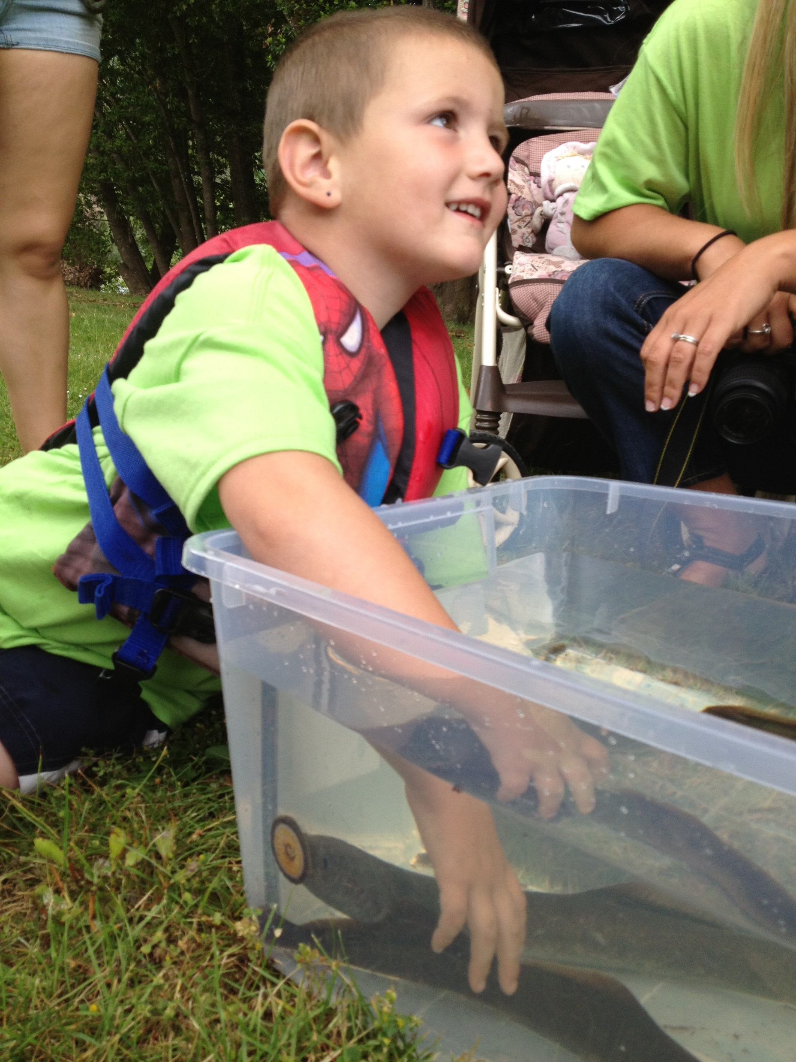
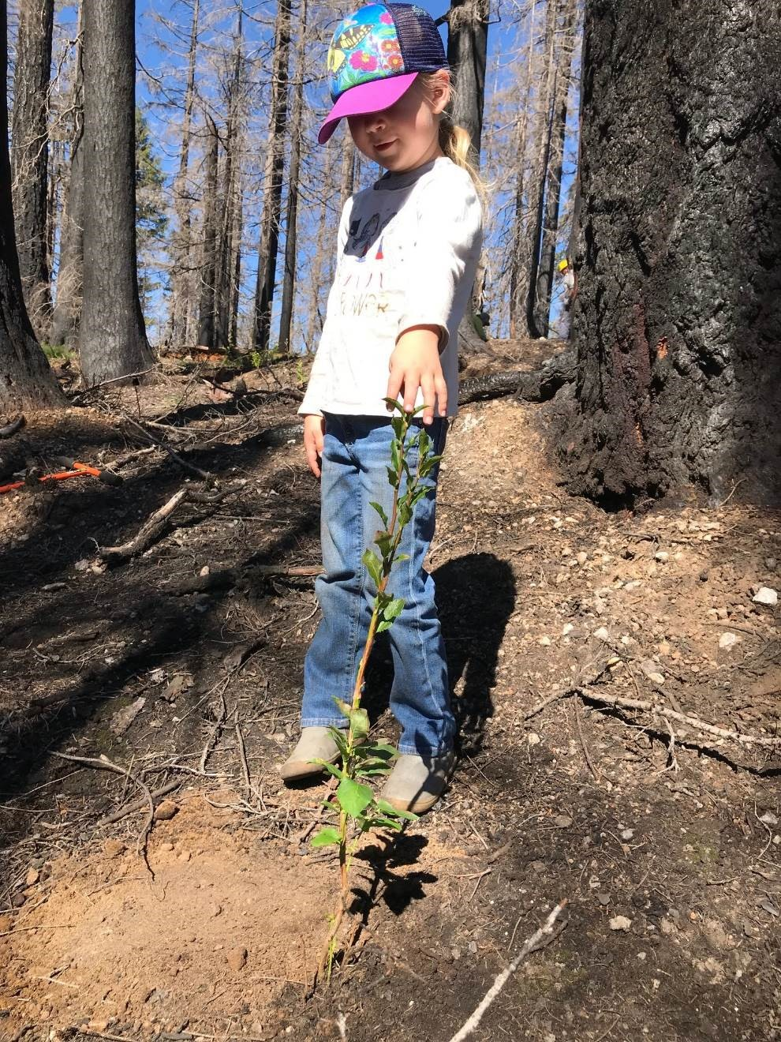
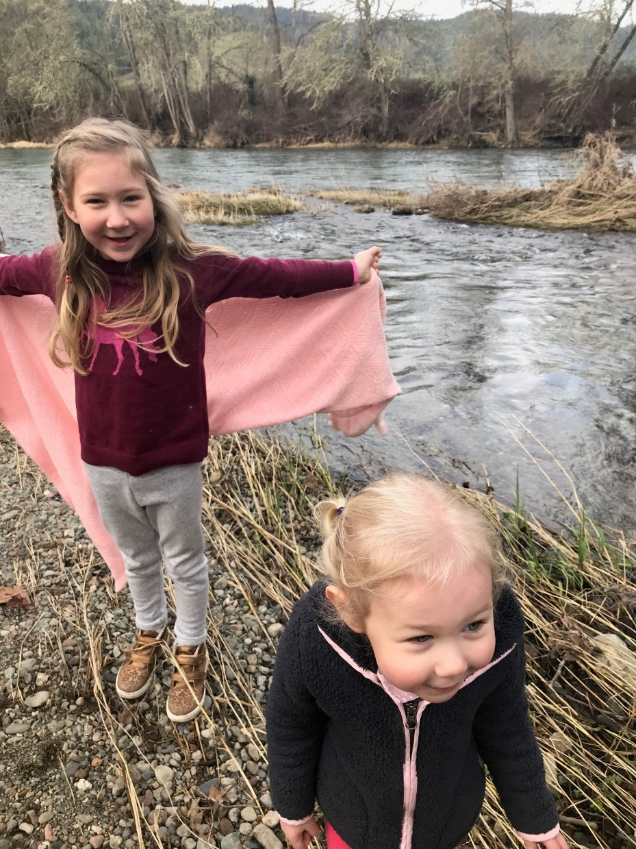
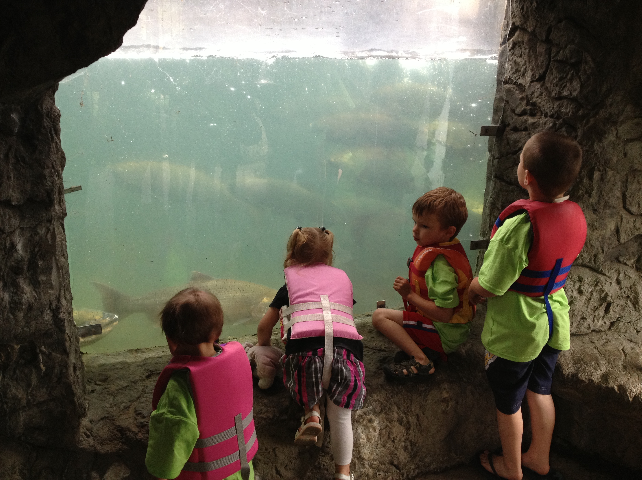
What This Means to The Cow Creek Umpqua Tribe
Notes:
Carla

Slide 27
Issue
Memorandum of Agreement to Define Exercise of Hunting, Fishing, Trapping, and Gathering by the Cow Creek Band of Umpqua Tribe of Indians and its Members and for Cooperative Management of Natural Resources between the Cow Creek Band of Umpqua Tribe of Indians and the State of Oregon, through the Oregon Department of Fish and Wildlife
Staff Recommendation: Adopt OAR 635-800-0200 (Attachment 4) to implement the Memorandum of Agreement between the Cow Creek Band of Umpqua Tribe of Indians and the state of Oregon, through the Oregon Department of Fish and Wildlife (Attachment 3, Addendum 1).

